Slide 1



Citizen LOGIN

Slide 2
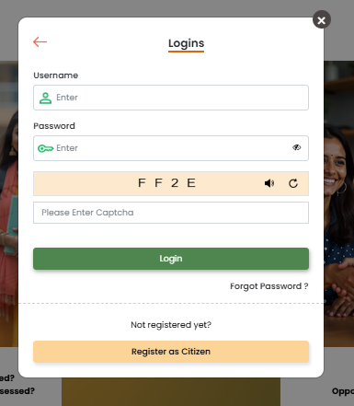
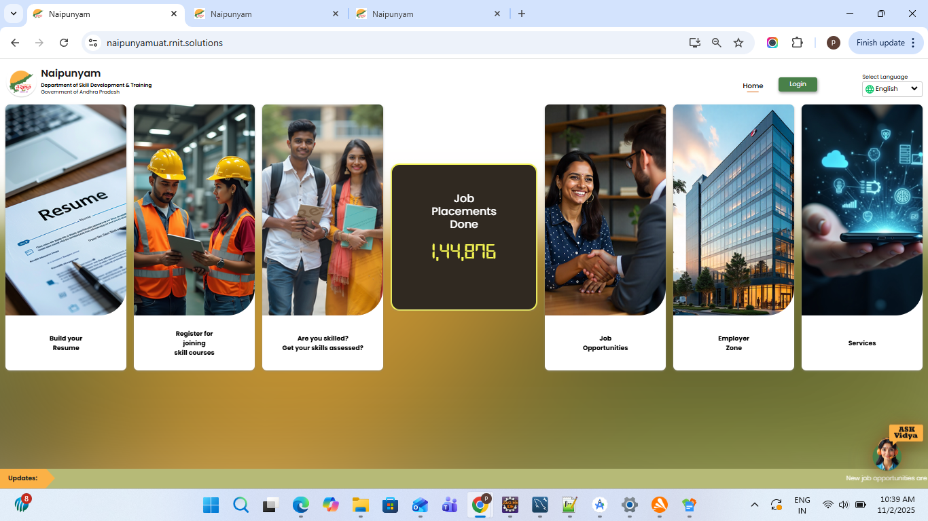
Citizen Registration
1. As First step user need do access web portal by accessing the following link On The Web Browser Page.
Web Url: https://naipunyam.ap.gov.in/
Following screen will Be Visible
2. Now the user can see both the Login and Home buttons on the Home page. The user needs to click on the Login button and select Citizen.
3. Enter the username and password, then click Login.
4.Here user need to click on register as citizen button, user can even do registration through resume build and registration of skill courses.

Slide 3
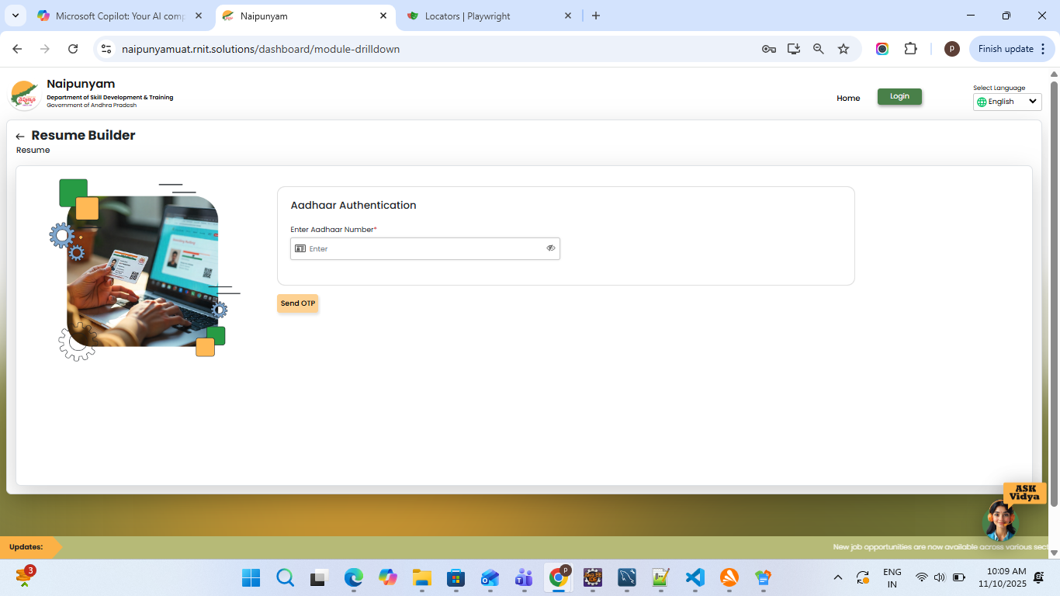
5.The user needs to enter the Aadhaar number and click on the Send OTP button.

Slide 4
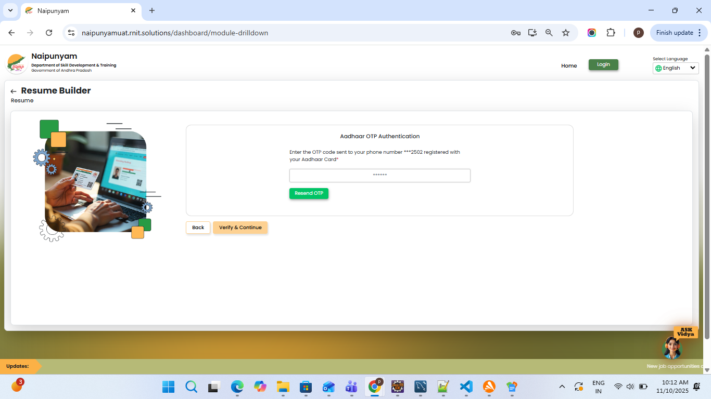
6. The user needs to enter the OTP and click on the Verify & Continue button.
7.If the user doesn’t receive the OTP, they need to click on the Resend OTP button.

Slide 5
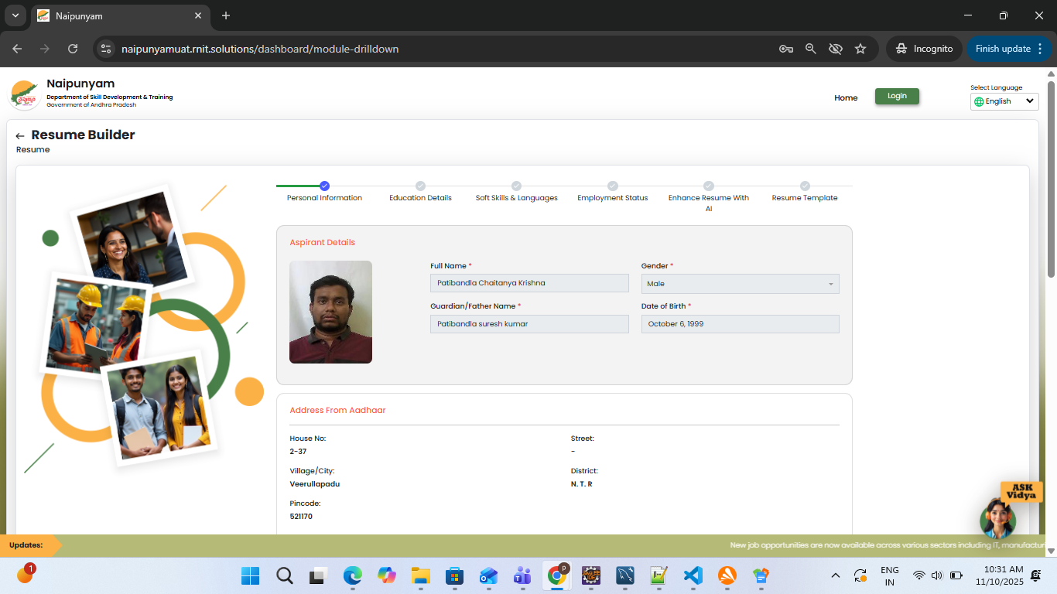
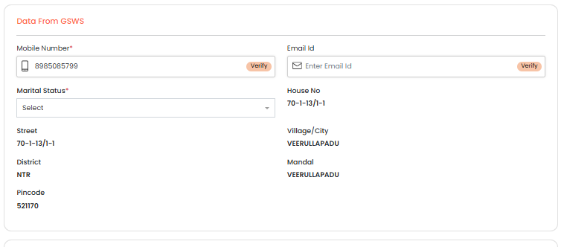
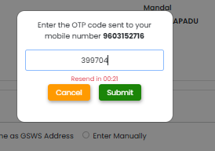
8. The user needs to enter the Mobile Number and Email ID, then click on the Verify button.
9.The user should enter the OTP and click on the Submit button.
10.The user needs to select the Marital Status from the dropdown.

Slide 6
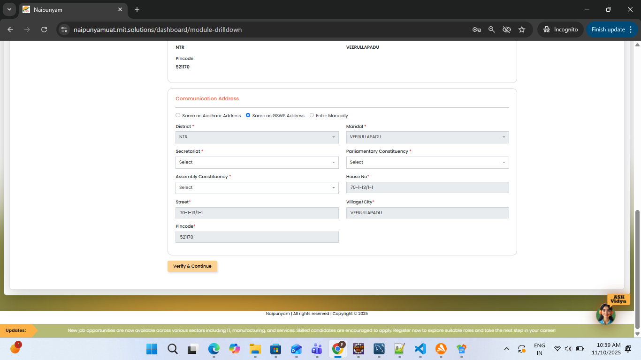
11. The user can select any of the following options — Same as Aadhaar Address, Same as GSWS Address, or Enter Manually — then enter the required details and click on the Verify & Continue button.

Slide 7
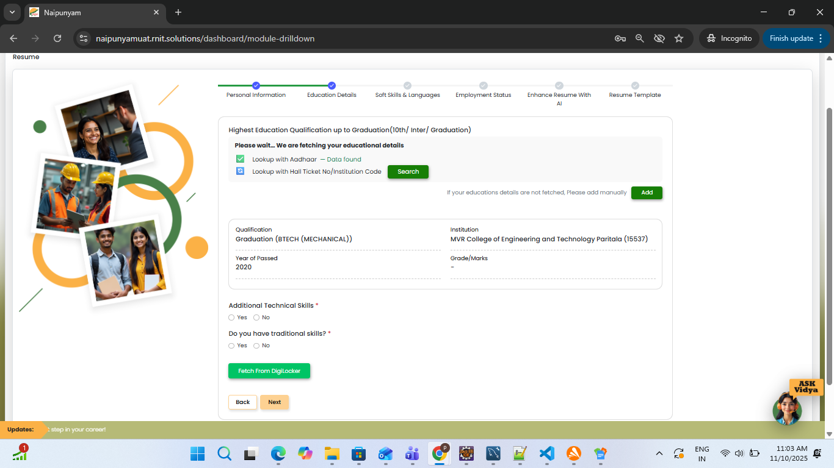
12.The user’s Educational Details will be pre-populated automatically. 13The user can click on the Search button to add educational details.
14.The user needs to click on the Add button to add the educational details.

Slide 8
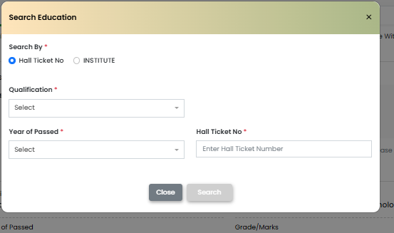
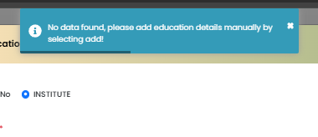
15.After clicking on the Search button, the user needs to select the Hall Ticket No or Institute radio button, enter all the required details, and click on the Search button.
16. After entering the details and clicking on the Search button, if the details do not match the Aadhaar number, the user will get a message — “No data found. Please add details manually” — as shown in the above screen.

Slide 9
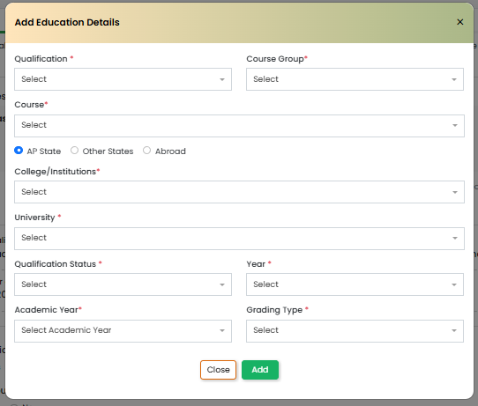
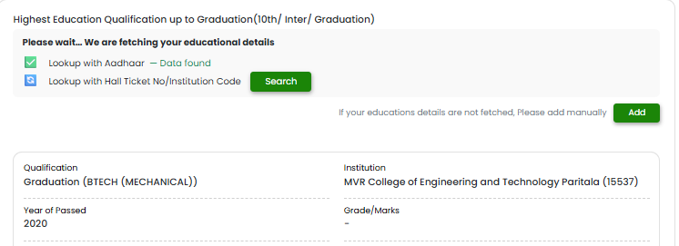
17.After clicking on the Add button, the user needs to enter all the required fields and click on the Add button again.
18. While entering the details, the user can select one of the following radio buttons — AP State, Other States, or Abroad — enter the details accordingly, and click on the Add button.
19.After adding the educational details, they will be displayed as shown in the above screen.

Slide 10
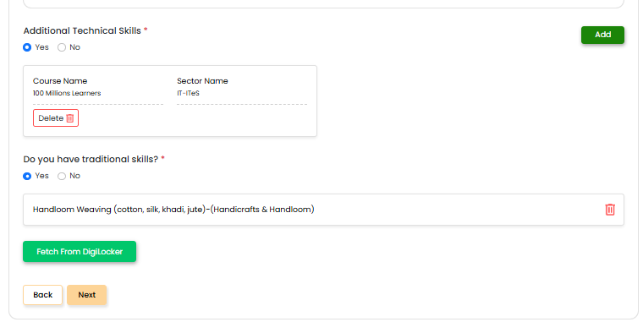
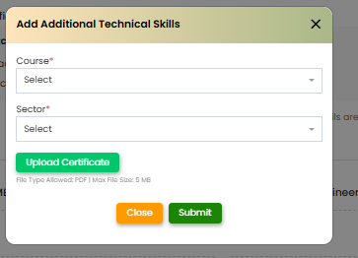
20.The user needs to select Yes/No radio buttons for Additional Technical Skills and Do you have Traditional Skills.
21.If the user selects Yes, they need to click on the Add button, enter all the details, and click on the Submit button.
22.If the user selects No, they can click on the Next button.
23.The user needs to click on the Fetch from Digilocker button.

Slide 11
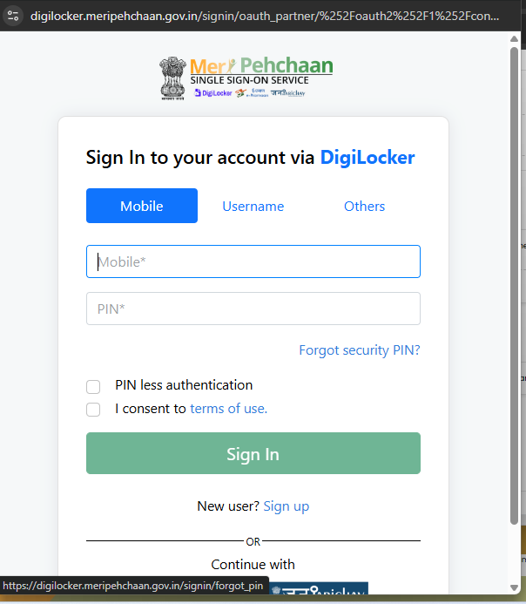
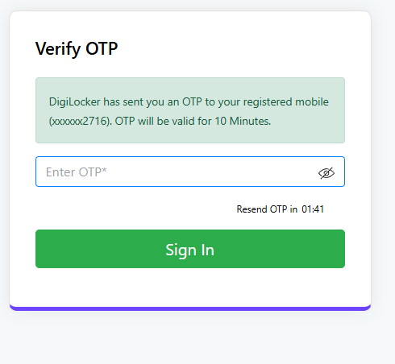
24.After clicking on Digilocker, the user needs to enter the required details and click on the Sign In button.
25.After entering the mobile number and selecting the Pinless radio button, the user needs to enter the OTP and click on the Sign In button.

Slide 12
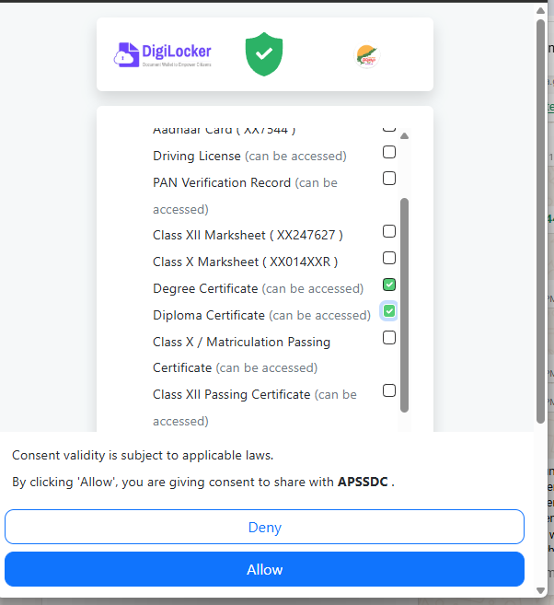
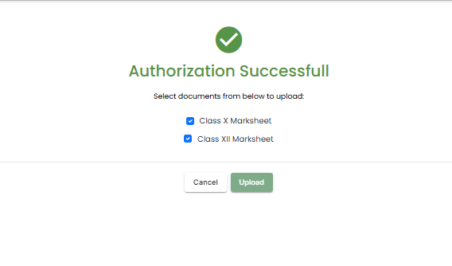
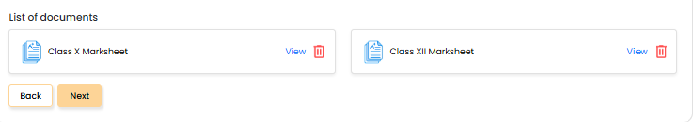
26.The user needs to select the checkboxes as shown on the screen and click on the Allow button.
27.As shown in the above screen, the user needs to select the documents and click on the Upload button.
28.After uploading the documents, they will be displayed on the screen as shown above. Then, the user needs to click on the Next button.

Slide 13
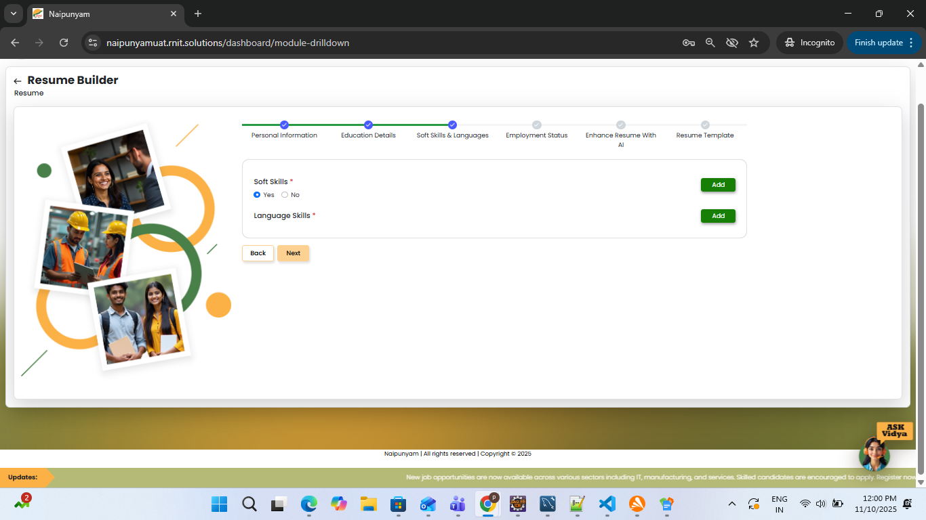
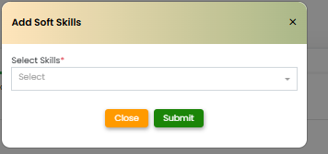
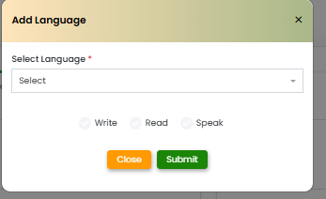
29.The user can select Yes or No radio button for Soft Skills.
30.If the user selects Yes, they need to click on the Add button.
31.Enter the required details and click on the Submit button.
32.The user then needs to click on the Add button under Language Skills, enter the details, and click on the Submit button.
33.The user now needs to click on the Next button.

Slide 14
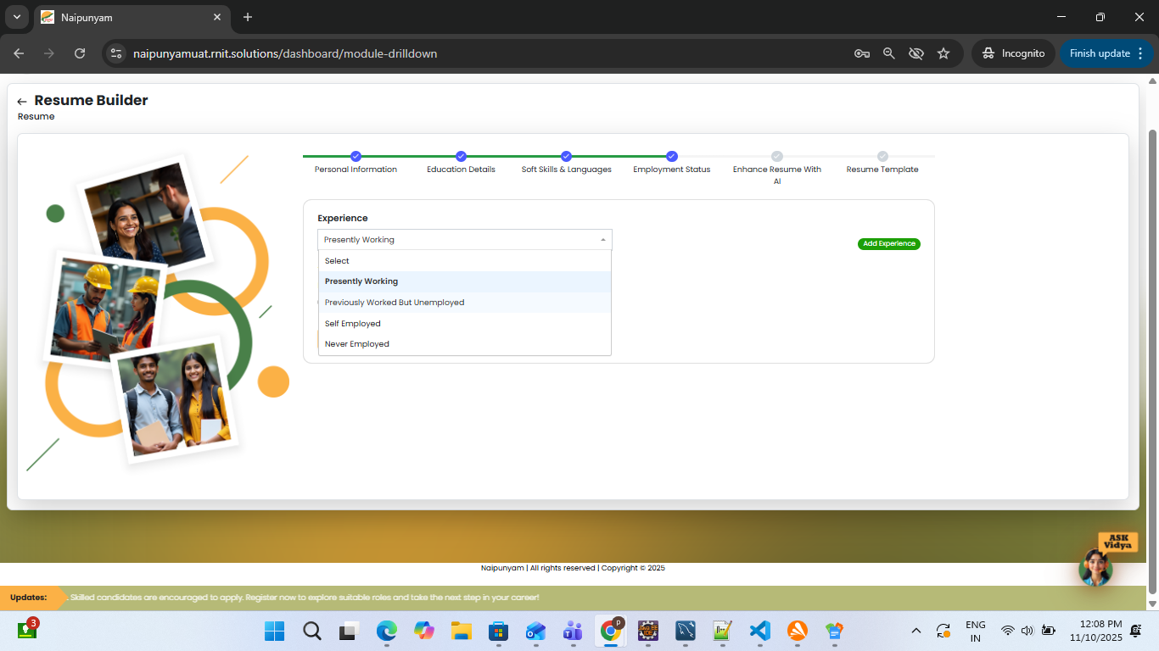
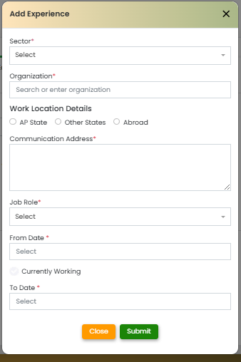
34.As shown in the above screen, if the user selects Presently Working or Previously Worked but Unemployed from the dropdown, they can click on the Add Experience button.
35.After clicking on the Add Experience button, the user needs to enter all the details and click on the Submit button.

Slide 15
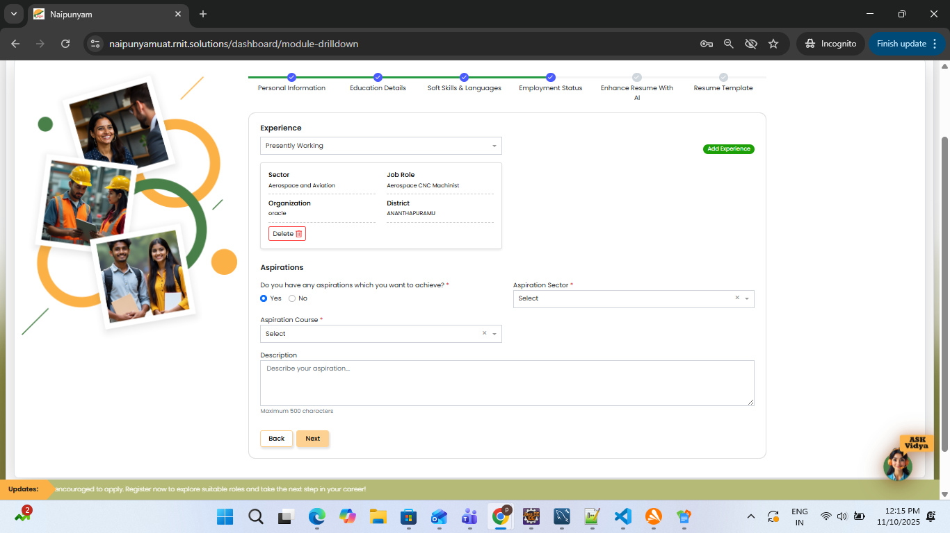
36.After adding the experience, it will be displayed as shown in the above screen.
37.The user now needs to select Yes/No radio buttons under Aspirations.
38.If the user selects Yes, they need to enter all the details and click on the Next button.

Slide 16
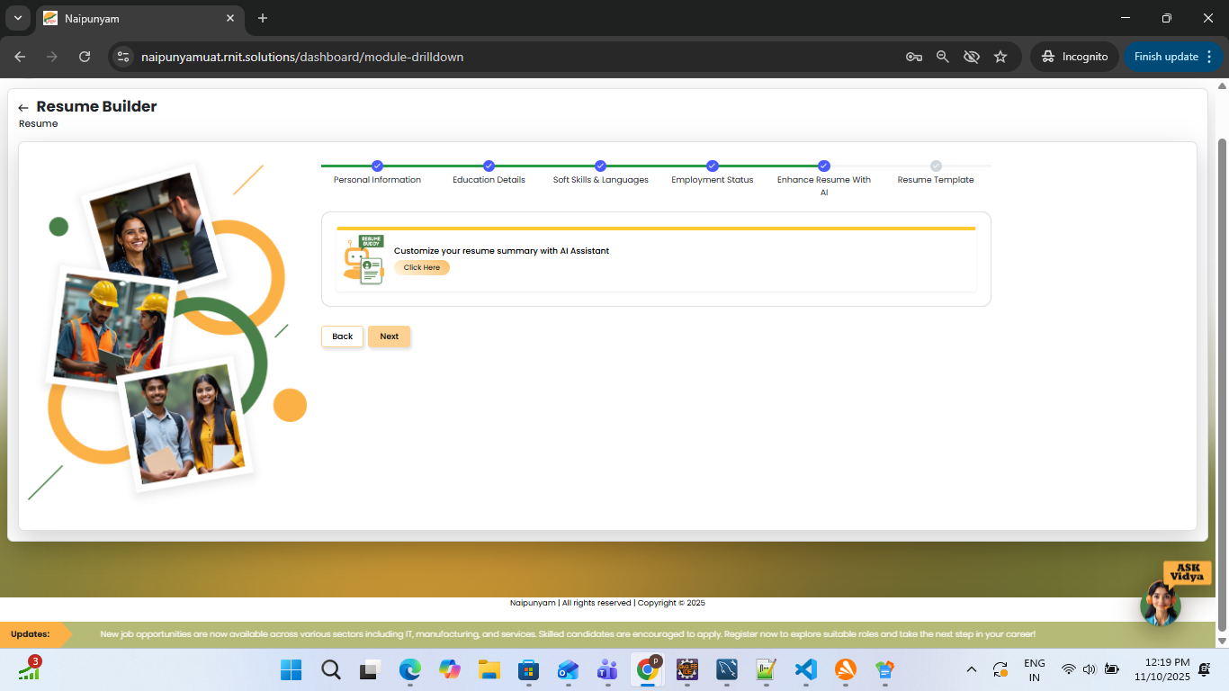
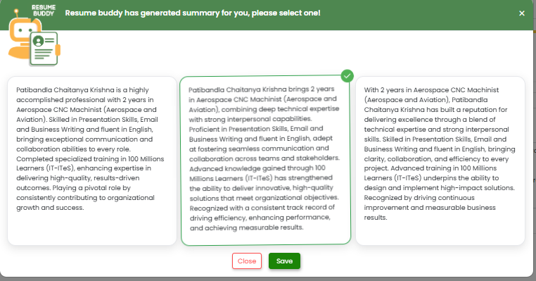
39.The user needs to click on the Click Here button.
40.The user needs to select any one of the available contents and click on the Save button.
41.After clicking on the Save button, the user needs to click on the Next button.

Slide 17
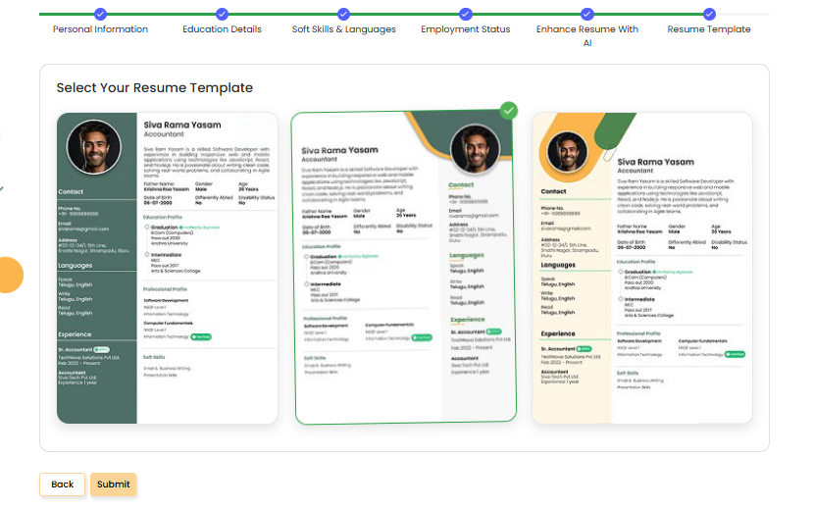
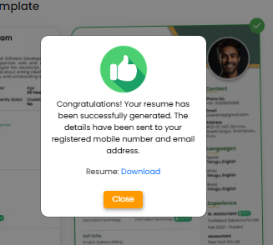
42.The user now needs to select a Resume Template and click on the Submit button.
43.The user can download the resume by clicking on the Download button.
44.The user will receive login details via mobile and email for logging in.

Slide 18
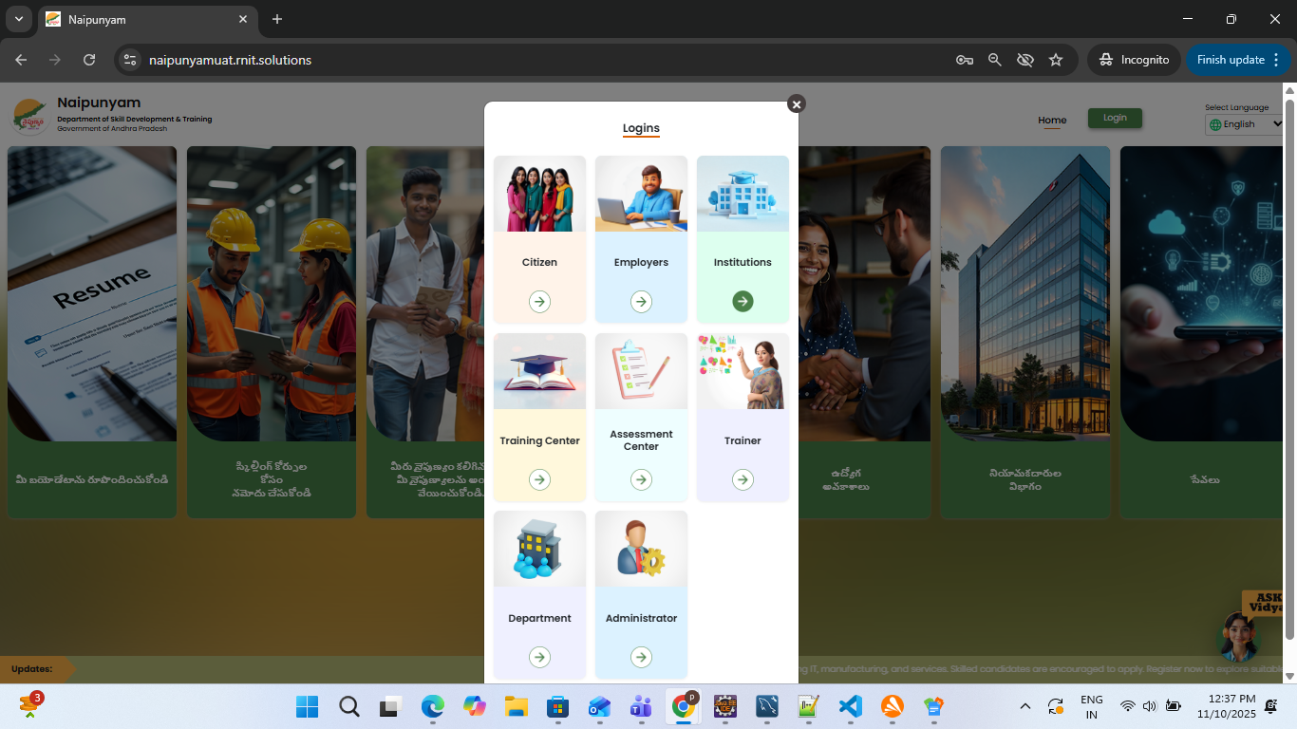
Citizen Login
45.Now, the user can see both the Login and Home buttons on the Home page. The user needs to click on the Login button and select Citizen.
46.Enter the Username and Password, then click on the Login button.

Slide 19
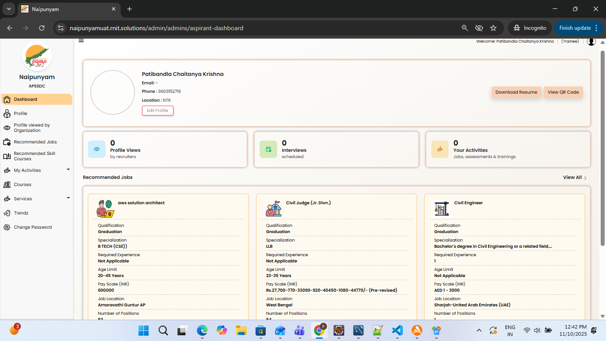
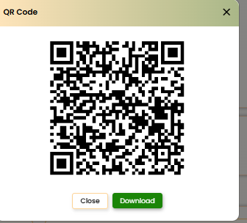
47.The user can click on Edit Profile to update their details.
48.The user can click on the Download Resume button to download the resume.
49.The user can click on the View QR Code button and either scan it or click on the Download button to download the resume.

Slide 20
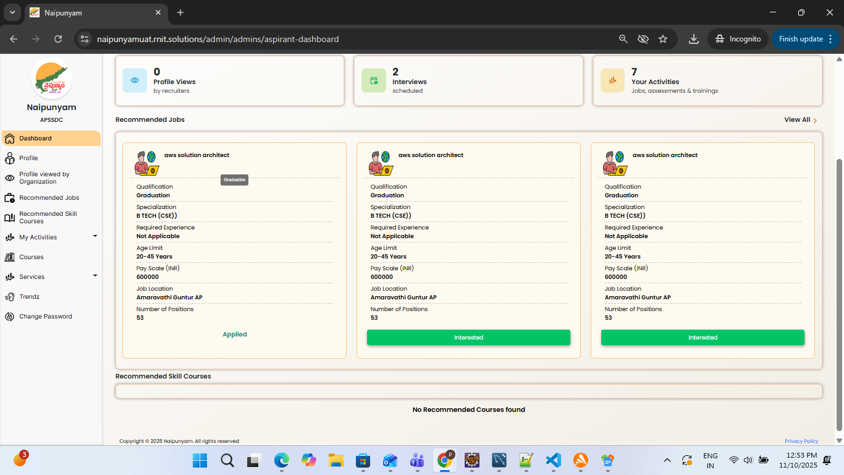
50.To apply for Recommended Jobs, the user can click on the Interested button from the list of Recommended Jobs.
51. To apply for Recommended Skill Courses, the user can click on the Interested button from the list of Recommended Skill Courses.

Slide 21
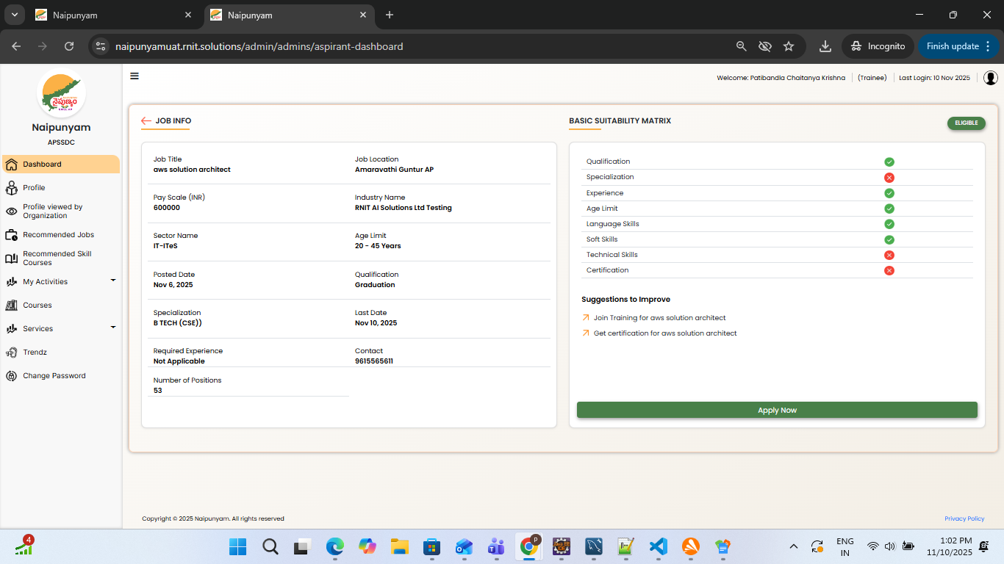
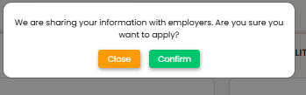
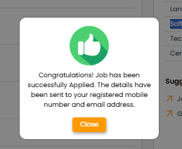
52.After clicking on the Interested button from the Recommended Jobs, the user can view the Job Info page.
53Here, the user can check eligibility under the Basic Suitability Matrix. If the Qualification, Specialization, Experience, Age Limit, Language Skills, and Soft Skills match, the user can click on the Apply Now button.
54.After clicking on the Apply Now button, the user needs to click on the Confirm button.
55. After applying for the job, as shown in the previous screen, the user can see the status as Applied.

Slide 22

User Registration into
AP FRS
This section describes steps to be performed for one time
registration into the FRS app.
This section describes steps to be performed for one time
registration into the FRS app.
This section describes steps to be performed for one time
registration into the FRS app.

